Slide 1
Course code | 19TP102L | Semester | II
Category | Humanities and Sciences Course (HSC) |  | L | T | P | C
Course Title | Quantitative Aptitude &Verbal Reasoning |  | 0 | 0 | 0 | 1
SYLLABUS
(Total contact hours =24 periods, No. of credits = 1)
Chapter 1: Verbal aptitude 8 hrs
Meanings of words, idioms, and phrases, secondary shades of meaning, usage, associated words, antonyms, etc. Verbal Reasoning questions to identify relationships or patterns within sentences or group of words.
Chapter 2: Grammar 4hrs
Grammar-based questions to mark and correct grammatical errors, use of articles, prepositions, use of modifiers, subject-verb agreement, parallel construction, phrasal verbs, redundancy, etc.

Slide 2
Chapter 3: RATIO AND PROPORTION
Chapter 4: PERMUTATION AND COMBINATIONS 4hrs
Profit and Loss - Time and Distance - Problems on Trains - Permutation and Combination – Probability - Time and Work - Pipes and Cisterns – Clocks
Chapter 5: RELATIONS AND CODING 4hrs
Blood Relations - Seating Arrangement - Symbols and Series - Syllogism - Direction Sense - Coding and Decoding - Cubes and Dice - Arithmetic

Slide 3
TEXT BOOK
1. Dr.R.S.Aggarwal, Quantitative Aptitude for Competitive Examinations (English) 7th Edition. S Chand Publishing 2015
2. Dr.R.S.Aggarwal, A Modern Approach To Verbal & Non Verbal Reasoning (English) Revised Edition, S Chand Publishing 2012.
3. Barron’s GRE Exam Book
REFERENCE BOOK
1.Abhijit Guha, Quantitative Aptitude for Competitive Examinations (English) 5th Edition, Tata McGraw Hill 2014
2.Nishit K Sinha, The Pearson Guide to Logical Reasoning and Data Interpretation for the
CAT and other MBA Entrance Examinations 4th Edition, Pearson 2013.

Slide 4
Chapter 3: RATIO AND PROPORTION
3. Averages
4. Percentages
1. Number system
2. H.C.F and L.C.M 5. Ratio
and Proportion
6. Problems on Ages
7. Partnership
8. Allegation and Mixture

Slide 5
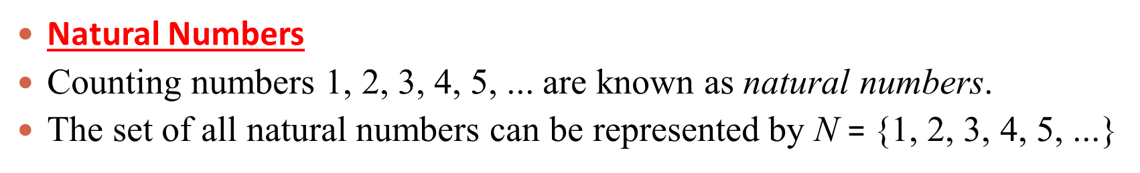
1. Number system
Whole Numbers
If we include 0 among the natural numbers, then the
numbers 0, 1, 2, 3, 4, 5, ... are called whole numbers.
The set of whole numbers can be represented by
W = {0, 1, 2, 3, 4, 5, ...}

Slide 6
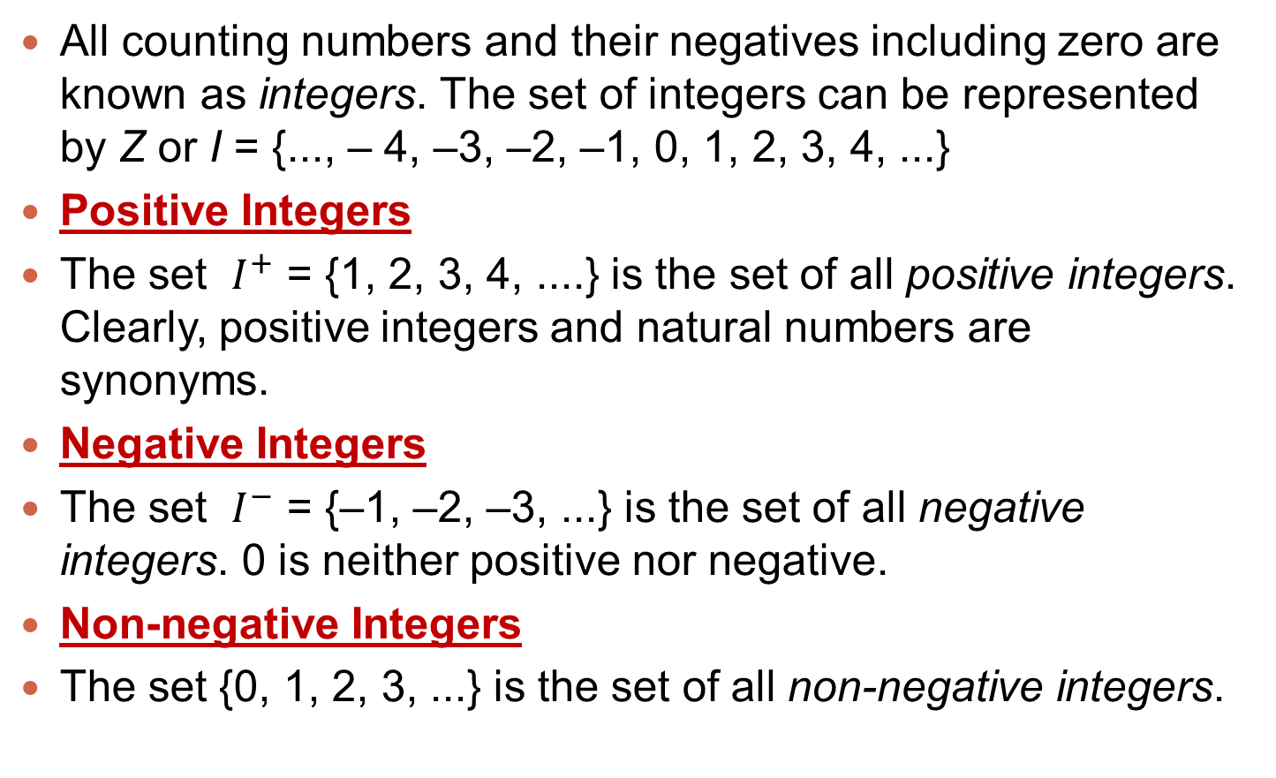
Integers
All counting numbers and their negatives including zero are known as integers. The set of integers can be represented by Z or I = {..., – 4, –3, –2, –1, 0, 1, 2, 3, 4, ...}
Positive Integers
The set $I^{+}$ = {1, 2, 3, 4, ....} is the set of all positive integers. Clearly, positive integers and natural numbers are synonyms.
Negative Integers
The set $I^{−}$ = {–1, –2, –3, ...} is the set of all negative integers. 0 is neither positive nor negative.
Non-negative Integers
The set {0, 1, 2, 3, ...} is the set of all non-negative integers.

Slide 7
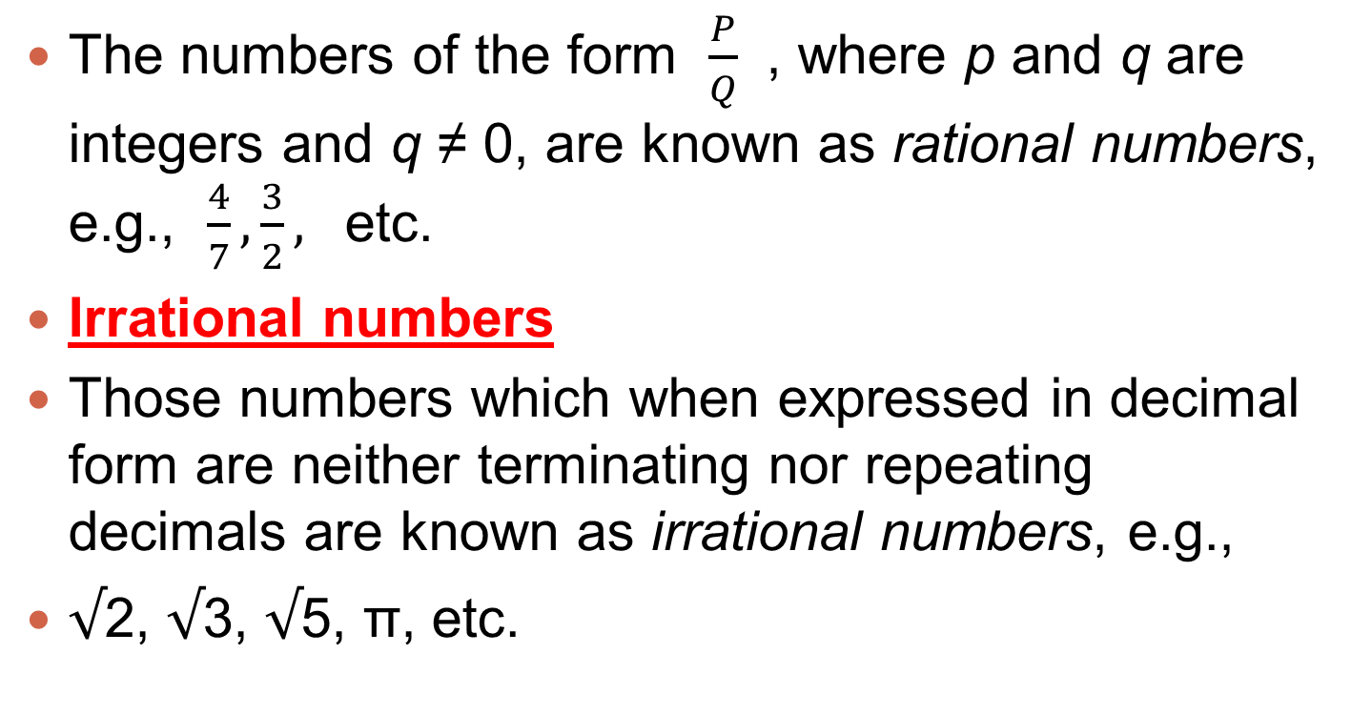
Rational Numbers
The numbers of the form $\frac{P}{Q}$ , where p and q are integers and q ≠ 0, are known as rational numbers, e.g., $\frac{4}{7}, \frac{3}{2},$ etc.
Irrational numbers
Those numbers which when expressed in decimal form are neither terminating nor repeating decimals are known as irrational numbers, e.g.,
$√$2, $√$3, $√$5, π, etc.

Slide 8
Prime numbers
A natural number other than 1, is a prime number if it is divisible by 1 and itself only.
For example, each of the numbers 2, 3, 5, 7, etc.,
are prime numbers.
composite numbers
Natural numbers greater than 1 which are not prime, are known as composite numbers.
For example, each of the numbers 4, 6, 8, 9, 12,
etc., are composite numbers.

Slide 9
Important Resuslts
1. The number 1 is neither a prime number nor a
composite number.
2. 2 is the only even number which is prime.
3. Prime numbers up to 100 are:
2, 3, 5, 7, 11, 13, 17, 19, 23, 29, 31, 37, 41, 43,
47, 53, 59, 61, 67, 71, 73, 79, 83, 89, 97,
i.e., 25 prime numbers between 1 and 100.
4. Two numbers which have only 1 as the common
factor are called co-primes or relatively prime to
each other, e.g., 3 and 5 are co-primes.

Slide 10
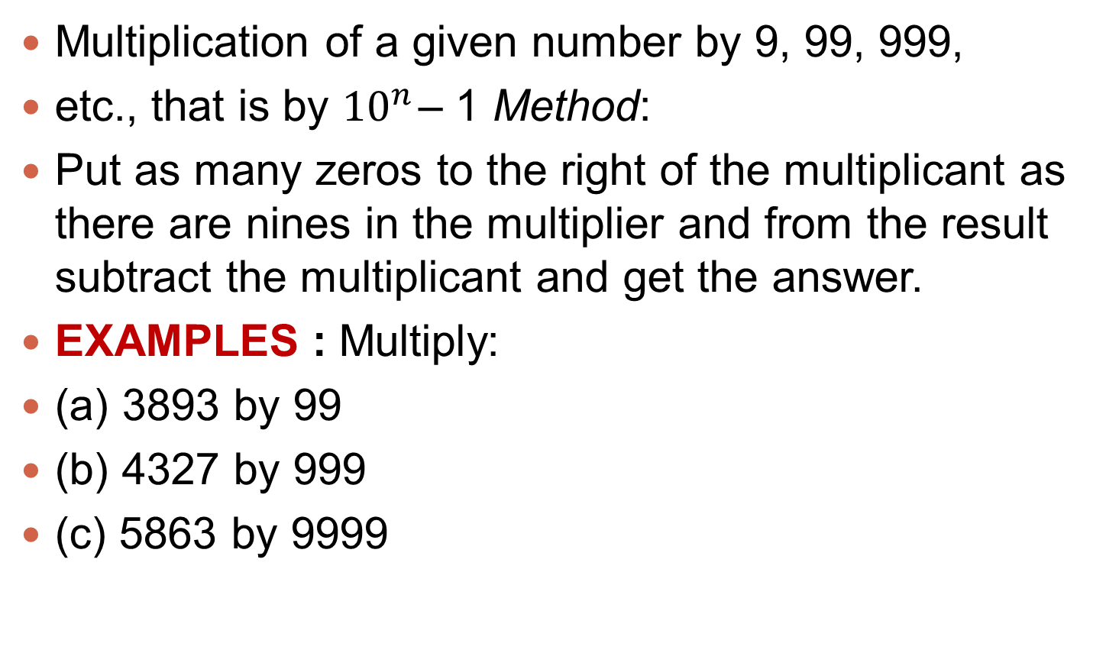
Multiplication
Multiplication of a given number by 9, 99, 999,
etc., that is by ${10}^{n}$ – 1 Method:
Put as many zeros to the right of the multiplicant as there are nines in the multiplier and from the result subtract the multiplicant and get the answer.
EXAMPLES : Multiply:
(a) 3893 by 99
(b) 4327 by 999
(c) 5863 by 9999

Slide 11
Solution:
(a) 3893 ⋅ 99 = 389300 – 3893
= 385407
(b) 4327 ⋅ 999 = 4327000 – 4327
= 4322673
(c) 5863 ⋅ 9999 = 58630000 – 5863
= 58624137

Slide 12
Exercise problems
2. A fraction becomes 4 when 1 is added to both the numerator and denominator; and it becomes 7 when 1 is subtracted from both the numerator and denominator. The numerator of the given fraction
1. Evalauate
9999 + 8888 + 777 + __ ? = 19700
(a) 36
(b) 16
(c) 64
(d) 26
7
3
2
15

Slide 13
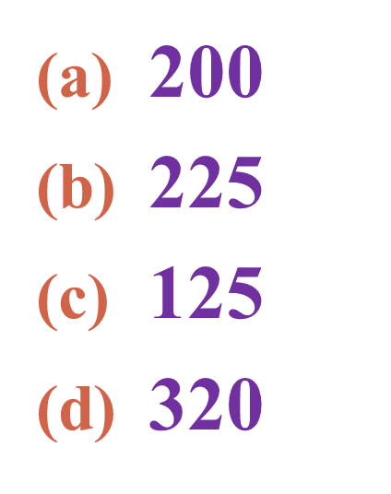
7. Divide 50 into two parts so that the sum of their reciprocals is 1/12.
6. If 16% of 40% of a number is 8, the number is:
20, 30
24, 26
28, 22
36, 14

Slide 14
THANK
YOU

